Slide 1

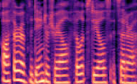

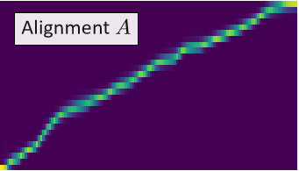
<Go> Frame
(Mel-spectrogram)
Text Feature Map
Speaker Feature Map
Teacher -force
Concat
Input 1
Source speaker audio (wav)
Mel-spectrogram
Speaker Encoder
TTS Decoder (Tacotron 2)
Attention
Input 2
Source speaker
Transcription (txt)
Text Encoder
generated
Mel-spectrogram
Residual Encoder
Matrix Multiply
Vocoder
(mel-gan)
Speaker independent linguistic features L
Concat
Output
audio (wav)
Input 3
Target speaker ID
Voice Conversion Decoder
(VC Decoder)
256D Embedding

Slide 2
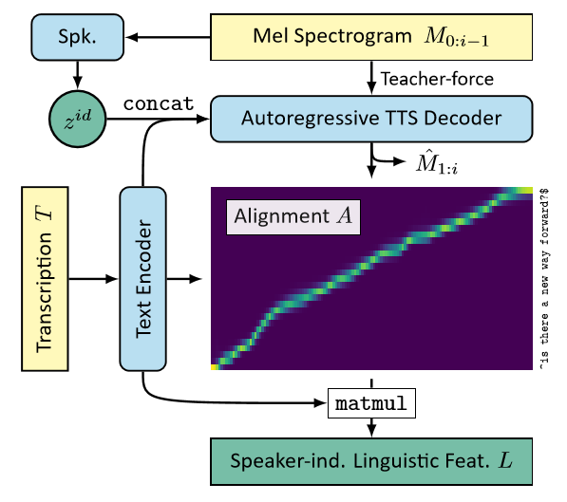

Slide 3
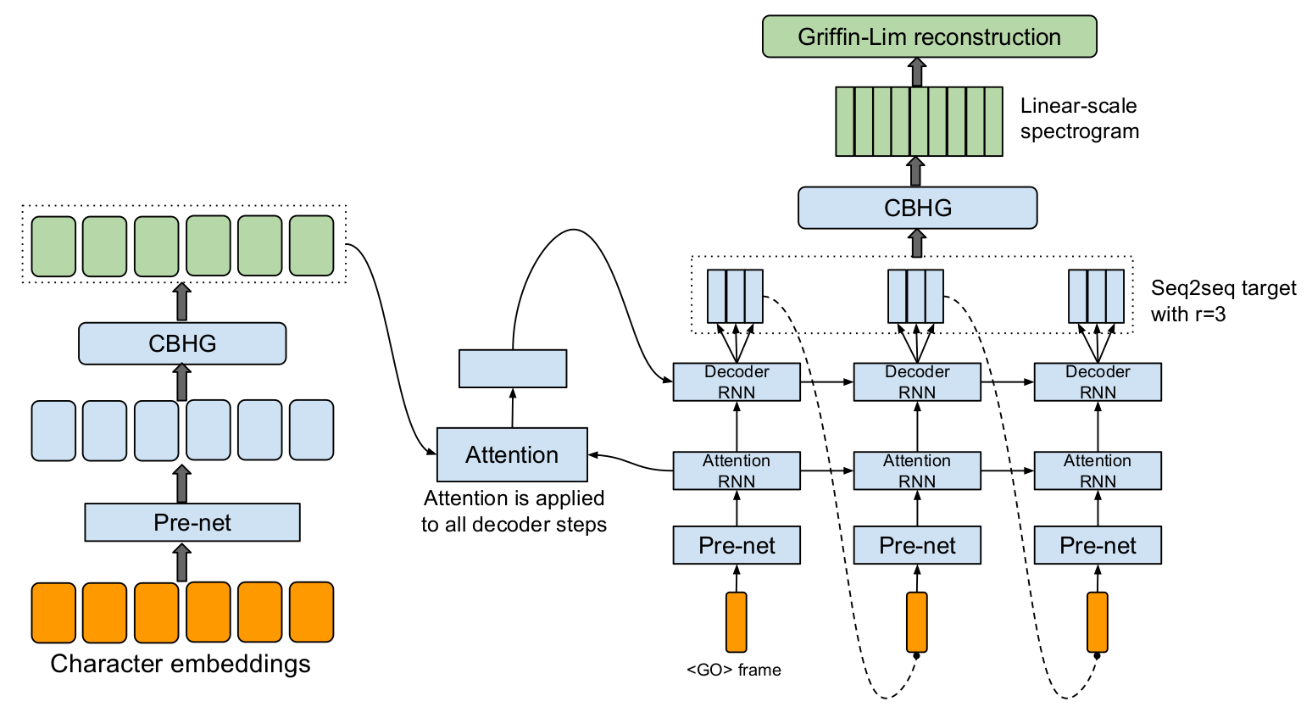
Post-net
Encoder

Slide 4
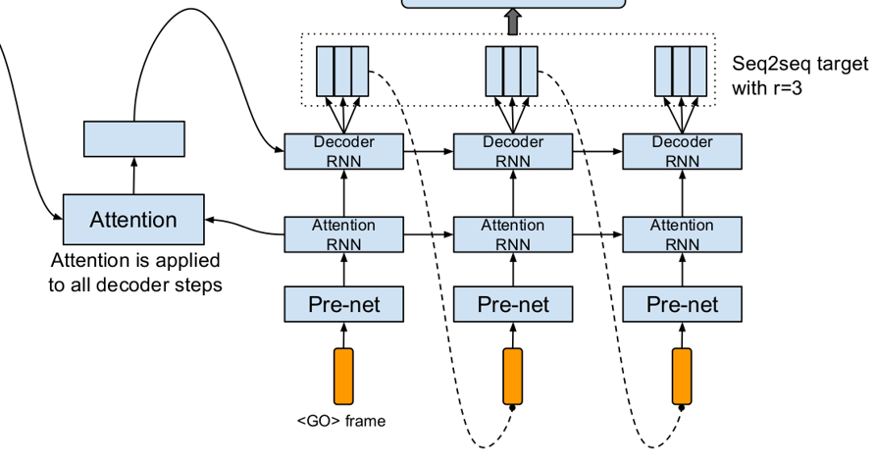

Slide 5
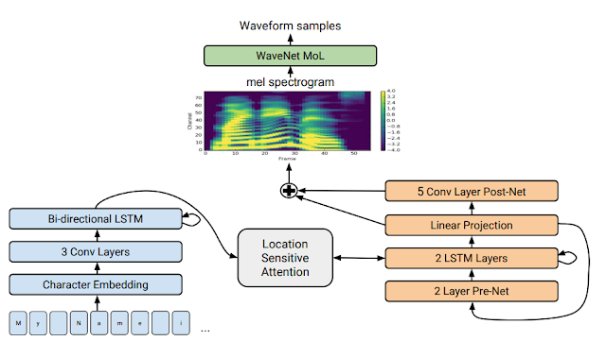
Encoder
Decoder

Slide 6
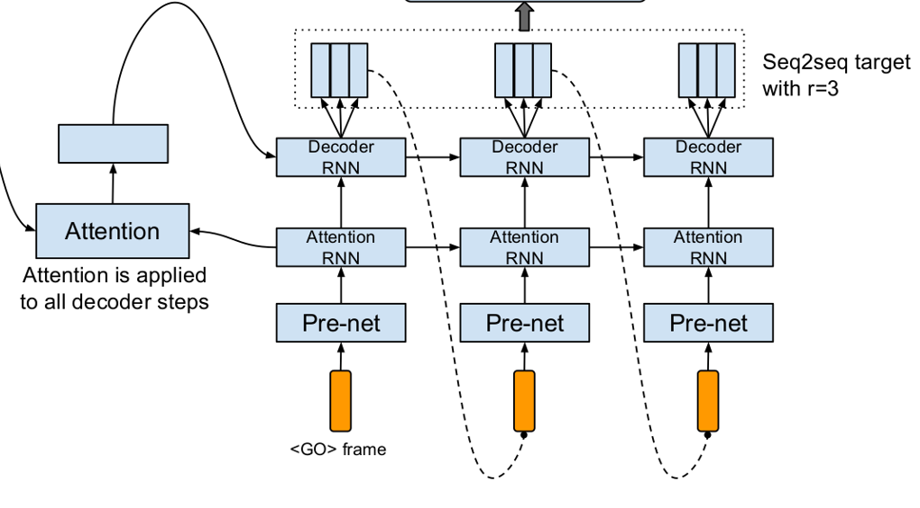
Mel-spectrogram
WaveNet MoL
Waveform samples
5 Conv Layer Post-Net
Linear Projection

Slide 7
COTATRON
Input 1
Source speaker audio (wav)
Mel-spectrogram
Speaker Encoder
Input 2
Source speaker
Transcription (txt)
Text Encoder
Speaker independent linguistic features L
Residual Encoder
LOSS calculation : MSE of two values
Input 3
Target speaker ID
Voice Conversion Decoder
(VC Decoder)
256D Embedding

Slide 8
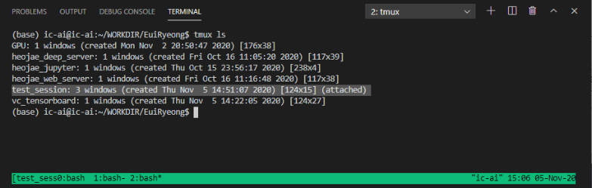

Slide 9

더빙 사용자
“안녕하세요! ㅇㅇ 입니다!
오늘 날씨가 참 좋네요!”
“안녕하세요! ㅇㅇ 입니다!
오늘 날씨가 참 좋네요!”
Voice conversion
Model
“안녕하세요! ㅇㅇ 입니다!
오늘 날씨가 참 좋네요!”
남녀 연령대 별 성우 목소리
“안녕하세요! ㅇㅇ 입니다!
오늘 날씨가 참 좋네요!”

